Slide 1
Chehalis River Basin Flood Authority Education and Outreach Subcommittee
Actions and Activities Benefiting the Basin
February 2013

Slide 2
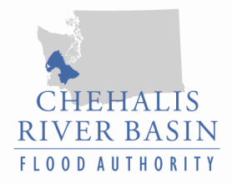
Today’s Presentation
Raise awareness
Encourage discussion
Key messages we’d like to leave you with . . .
Broad agreement -- For the first time in a century there is broad agreement on the next steps to reduce flood damage and enhance salmon runs in the Basin.
Basin-wide strategy -- A Basin-wide strategy can protect communities along the river and enhance salmon runs.
Flood Authority – Positioned to continue to be a galvanizing force in the Basin for implementation of tools, and projects.
Discussion

Slide 3
Chehalis River Basin Flood Authority
Formed in 2008
Formal body focused on (1) flood hazard mitigation throughout the Basin and (2) decisions that would be . . .
informed by science
protective of Basin residents/communities
environmentally appropriate
Basin jurisdictions represented
Grays Harbor County
Lewis County
Thurston County
City of Aberdeen
City of Centralia
City of Chehalis
City of Cosmopolis
City of Montesano
City of Napavine
City of Oakville
Town of Pe Ell
Town of Bucoda

Slide 4
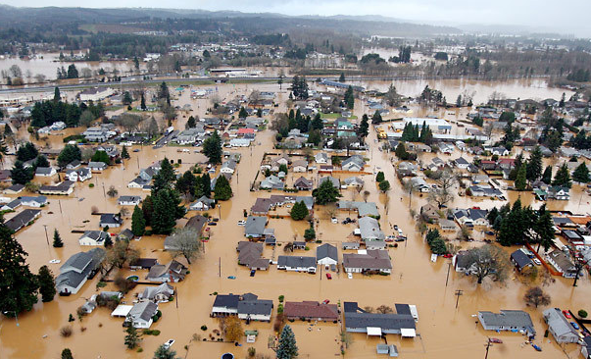
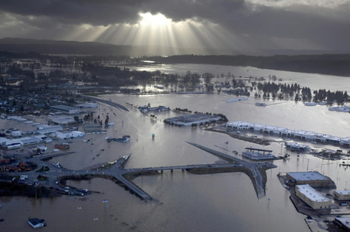
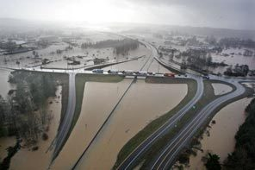
Background
2007 Flood -- $938 million in damage (Basin-wide)
City of Centralia
STEVE RINGMAN / SEATTLE TIMES
City of Chehalis
BRUCE ELY / THE OREGONIAN
Exit 77 (I-5) in Chehalis
STEVE RINGMAN / SEATTLE TIMES

Slide 5
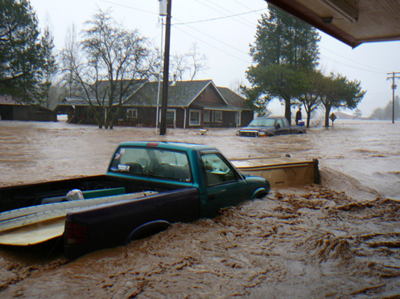
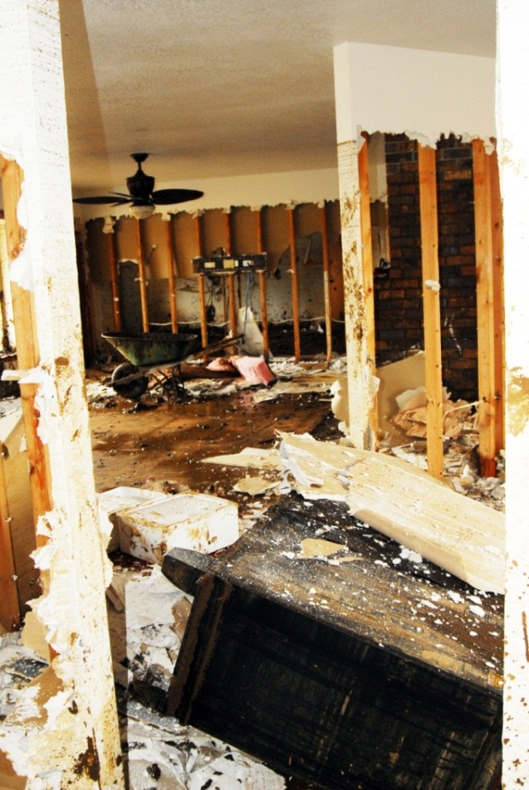
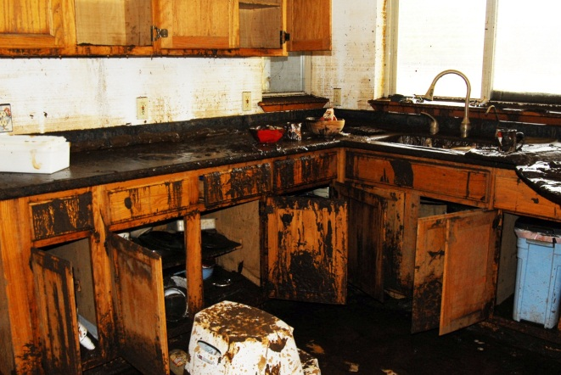
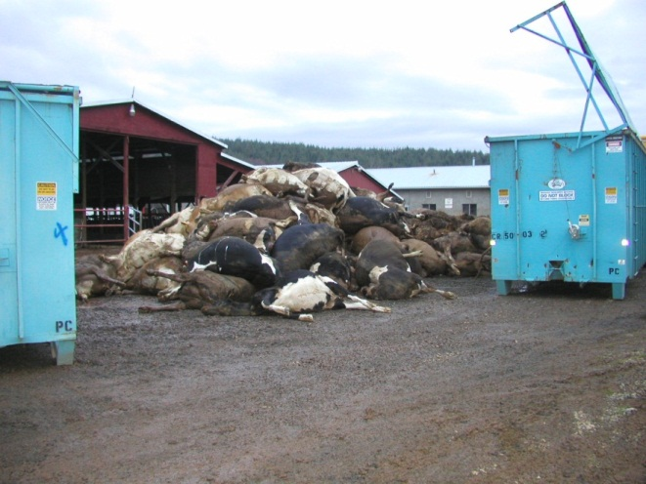
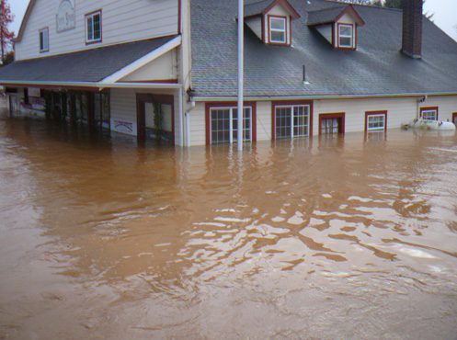
Background
2007 Flood -- $300 million in lost economic activity (Washington State)
Photos Source: Lewis County,
Division of Emergency Management

Slide 6
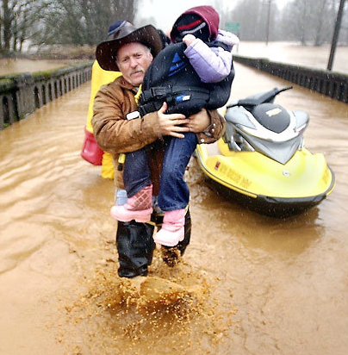
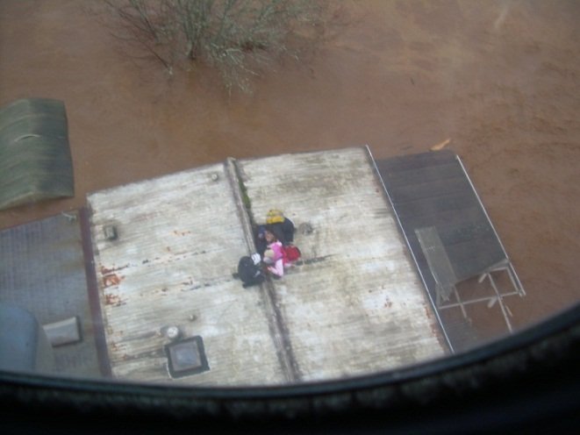
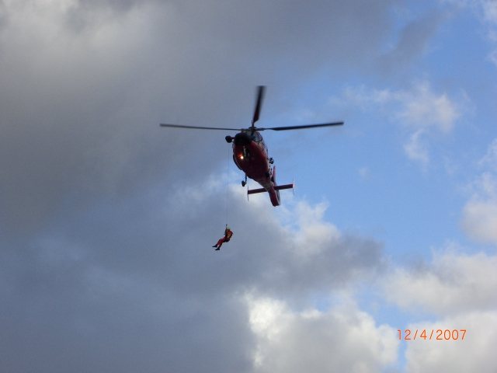
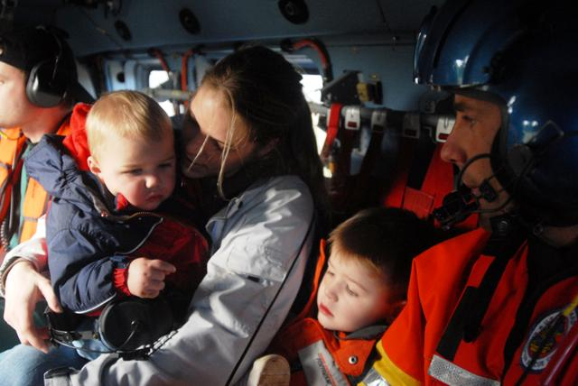
Background
2007 Flood – Immense impact on the lives of victims, responders alike
Photos Source: Lewis County,
Division of Emergency Management

Slide 7
Background
High flow events . . .
I-5 closed 1990, 1996, 2007, 2009
Five largest events since 1986 -- Frequent Floods are getting worse and damage is increasing . . .
Chart -- Chehalis River Flow Rates near Grand Mound (cubic ft./sec.)

Slide 8
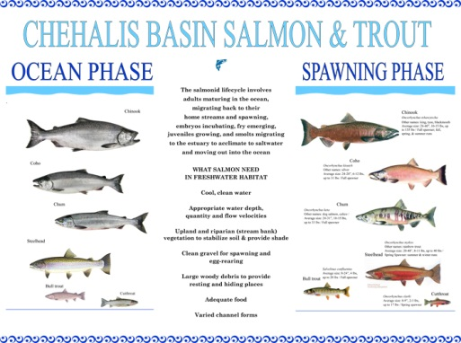
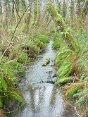
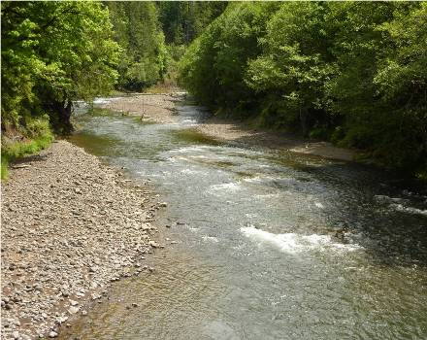
Background
Chehalis is the second largest river basin in the state, rich in natural resources . . .

Slide 9
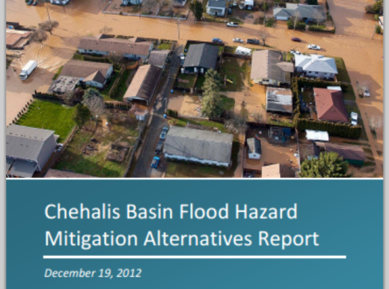
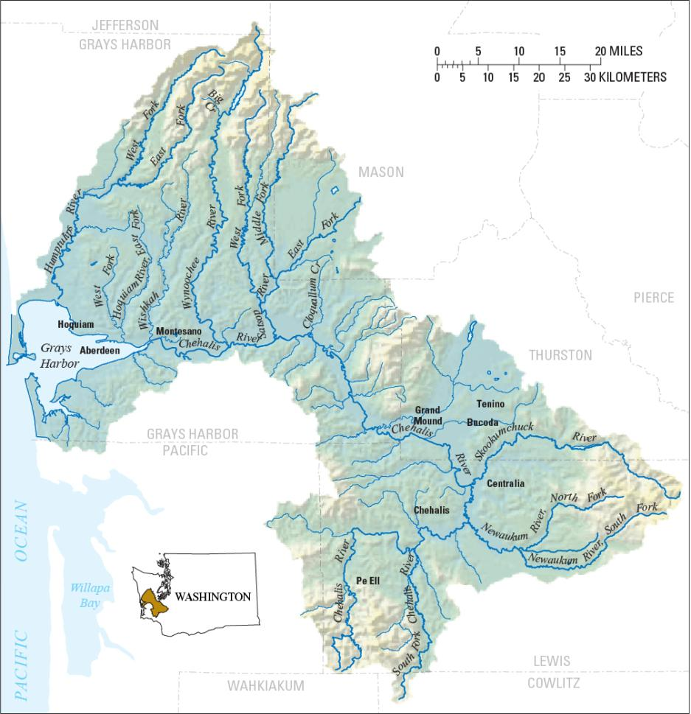
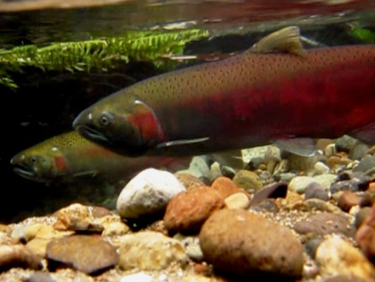
Need -- Strategy, Tools, Action. . .
Strategy = Basin-Wide Solution
Significant reduction of flood damage.
Solving one area’s problems doesn’t increase problems for others.
Maintain focus in five areas:
major capital projects
localized projects
land use management
environmental enhancements
flood warning and emergency response
William D. Ruckelshaus Center

Slide 10
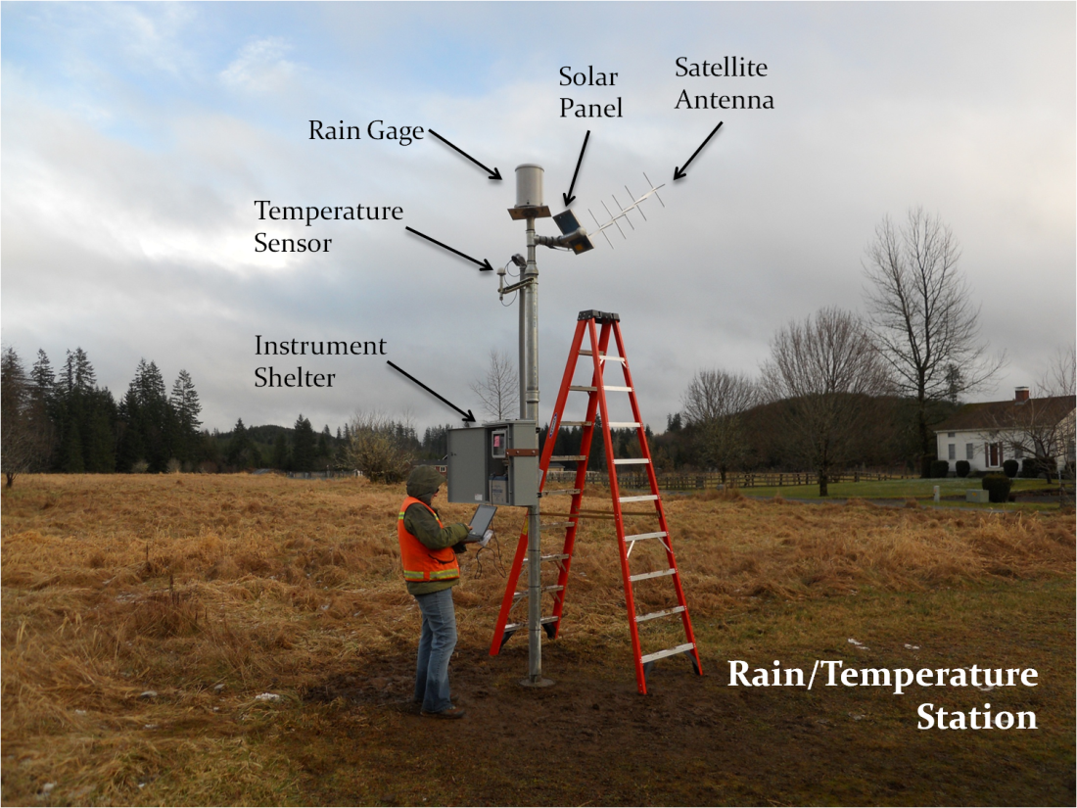
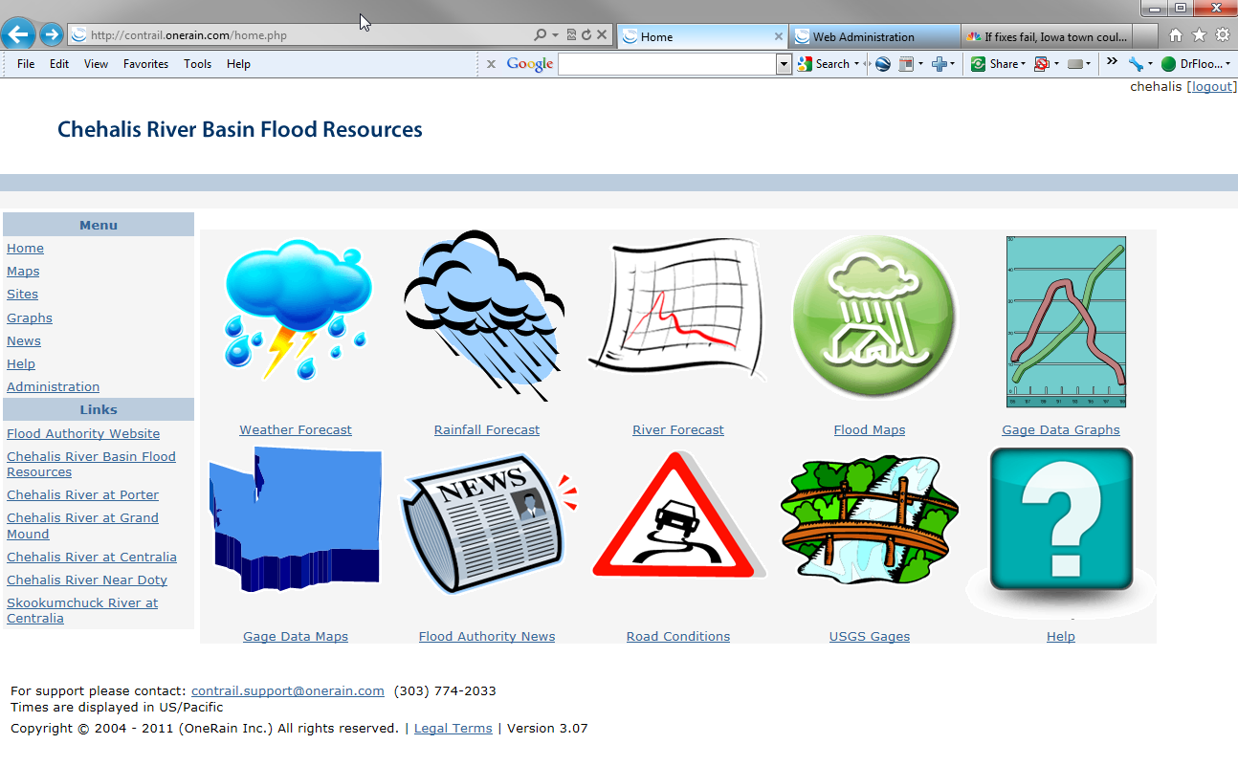
Tools -- Flood Warning System
www.chehalisriverflood.com
Front-facing website.
Back-end data collection and data synchronization system.
Improves forecasting and early-warning.

Slide 11
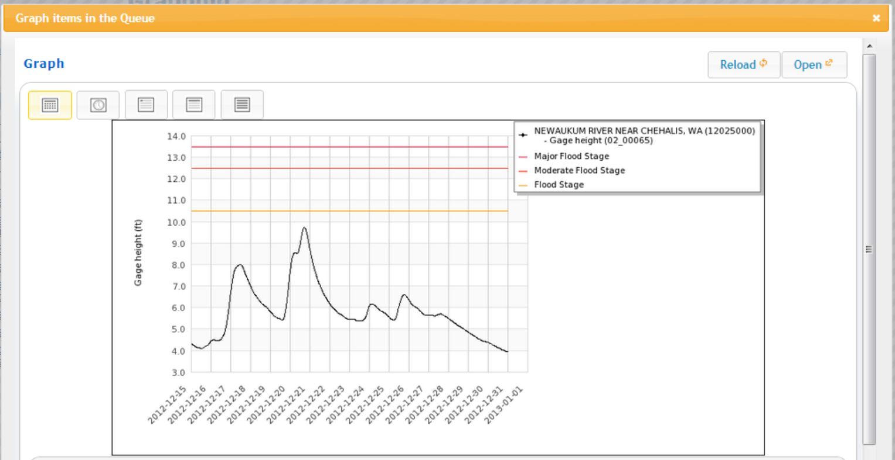
Tools -- Flood Warning System
Localized tracking, forecasting . . .
Chehalis River near Grand Mound
www.chehalisriverflood.com

Slide 12
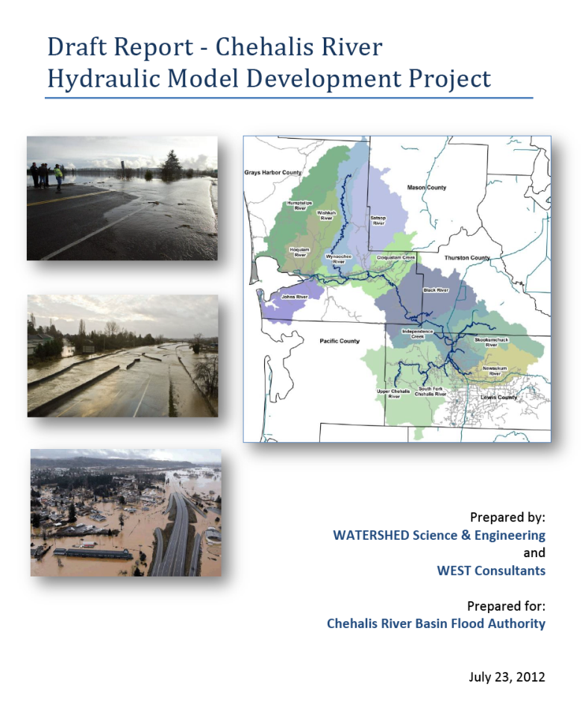
Tools -- Hydraulic Analysis Model
Science-based model to inform decision-makers on the hydraulic effects of potential flood relief alternatives (at basin-wide and localized scales).
25 potential flood relief projects or project combinations were analyzed/evaluated with the model.
Covers mouth of the Chehalis River upstream to Pe Ell (108 miles).

Slide 13
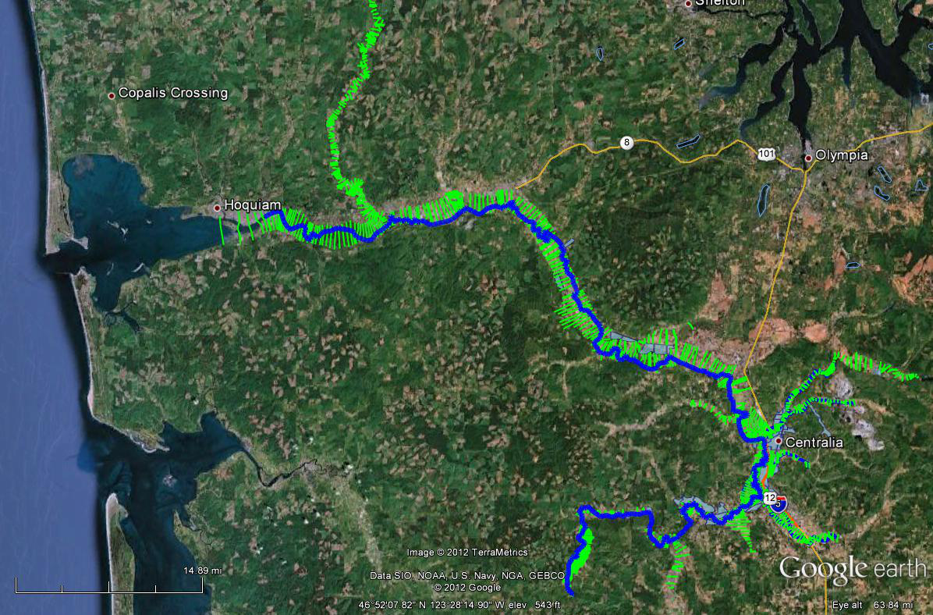
Tools -- Hydraulic Analysis Model
Now have analytic ability to understand potential project effects, downstream and up.

Slide 14
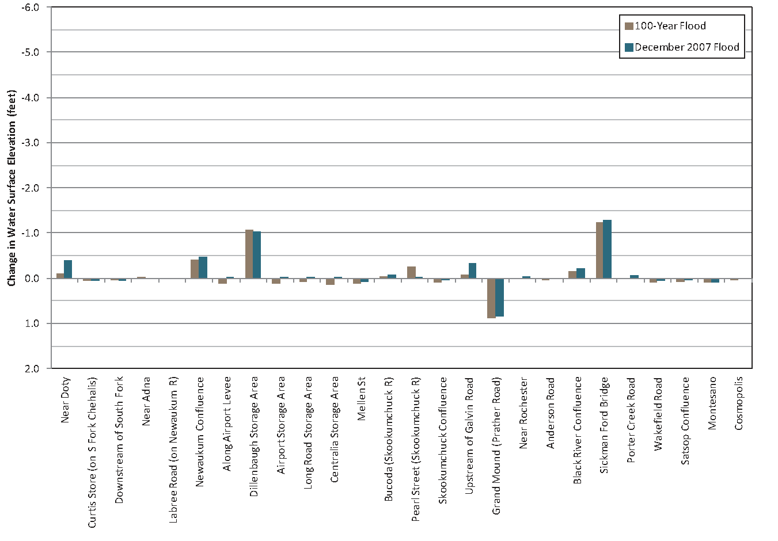
Tools -- Hydraulic Analysis Model
Example: Basin-wide effects analysis (Chehalis Basin Flood Hazard Mitigation Alternatives Report, 12/2012)

Slide 15
Tools -- Fish Studies
Two significant fish studies conducted in Upper Basin (WRIA 23).
Analyze effect of dam alternatives on Spring Chinook, Steelhead and Coho.
Prioritize potential fish habitat enhancement opportunities.
Initial projections . . .
Species | Multi-Purpose Dam | Flood Control-Only Dam | Fish Habitat Enhancement Measures
Spring Chinook | 20%  | 4%  | likely same as Coho
Steelhead | 7%  | 11%  | likely same as Coho
Coho | 1%  | 1%  | 4-5% 

Slide 16
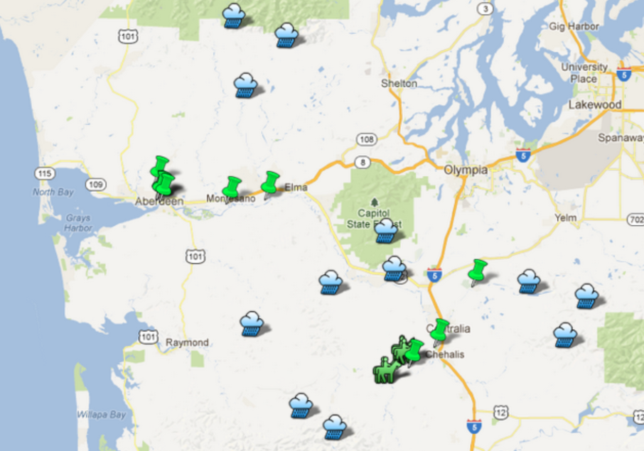
Action -- 2012 Jobs Now Act Projects
$5,000,000 provided under 2012 Jobs Now Act.
$1,875,000 -- Repair/modification of levees and dikes.
$2,075,000 -- Modification of Sickman Ford bridge, and floodplain culverts.
$50,000 -- Installation/calibration of rain gauge on Chehalis reservation.
$500,000 -- Construction of evacuation routes and critter pads.
$500,000 -- Improvements to areas affected by Satsop river.
Half the funds allocated to date.
Adna
Aberdeen
Bucoda
Chehalis- Centralia Airport
See http://goo.gl/maps/v7vO3.
Grays Harbor County
Montesano
WA Conservation Commission

Slide 17
Action -- 2013 Proposed State Capital Budget
Governor workgroup convened to develop prioritized list of projects for 2013 state capital budget based on Basin-wide solution.
Chehalis Tribe
Chehalis Flood Authority
Washington Dairy Federation
Governor’s staff
Proposed budget . . .
Construct local flood damage reduction projects now ($10.7 million)
Complete design alternatives for large-scale flood damage reduction projects ($9.2 million):
Upper basin water retention-engineering and design
I-5 protection options
Construct multipurpose projects that reduce flood damage and benefit fish ($4.3 million)
Reduce residential damage ($1.8 million)
Ensure successful implementation ($2.2 million)

Slide 18
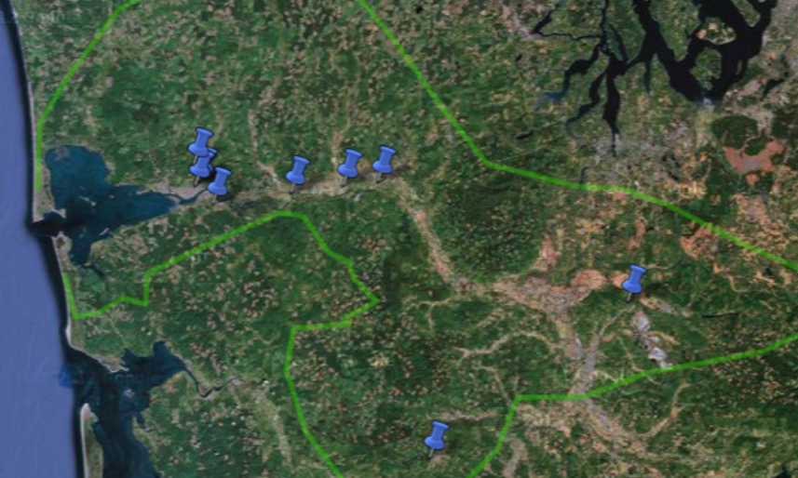
Action -- 2013 Proposed State Capital Budget
Proposed budget ($10.7 million for local projects) . . .
http://goo.gl/maps/gWob9

Slide 19
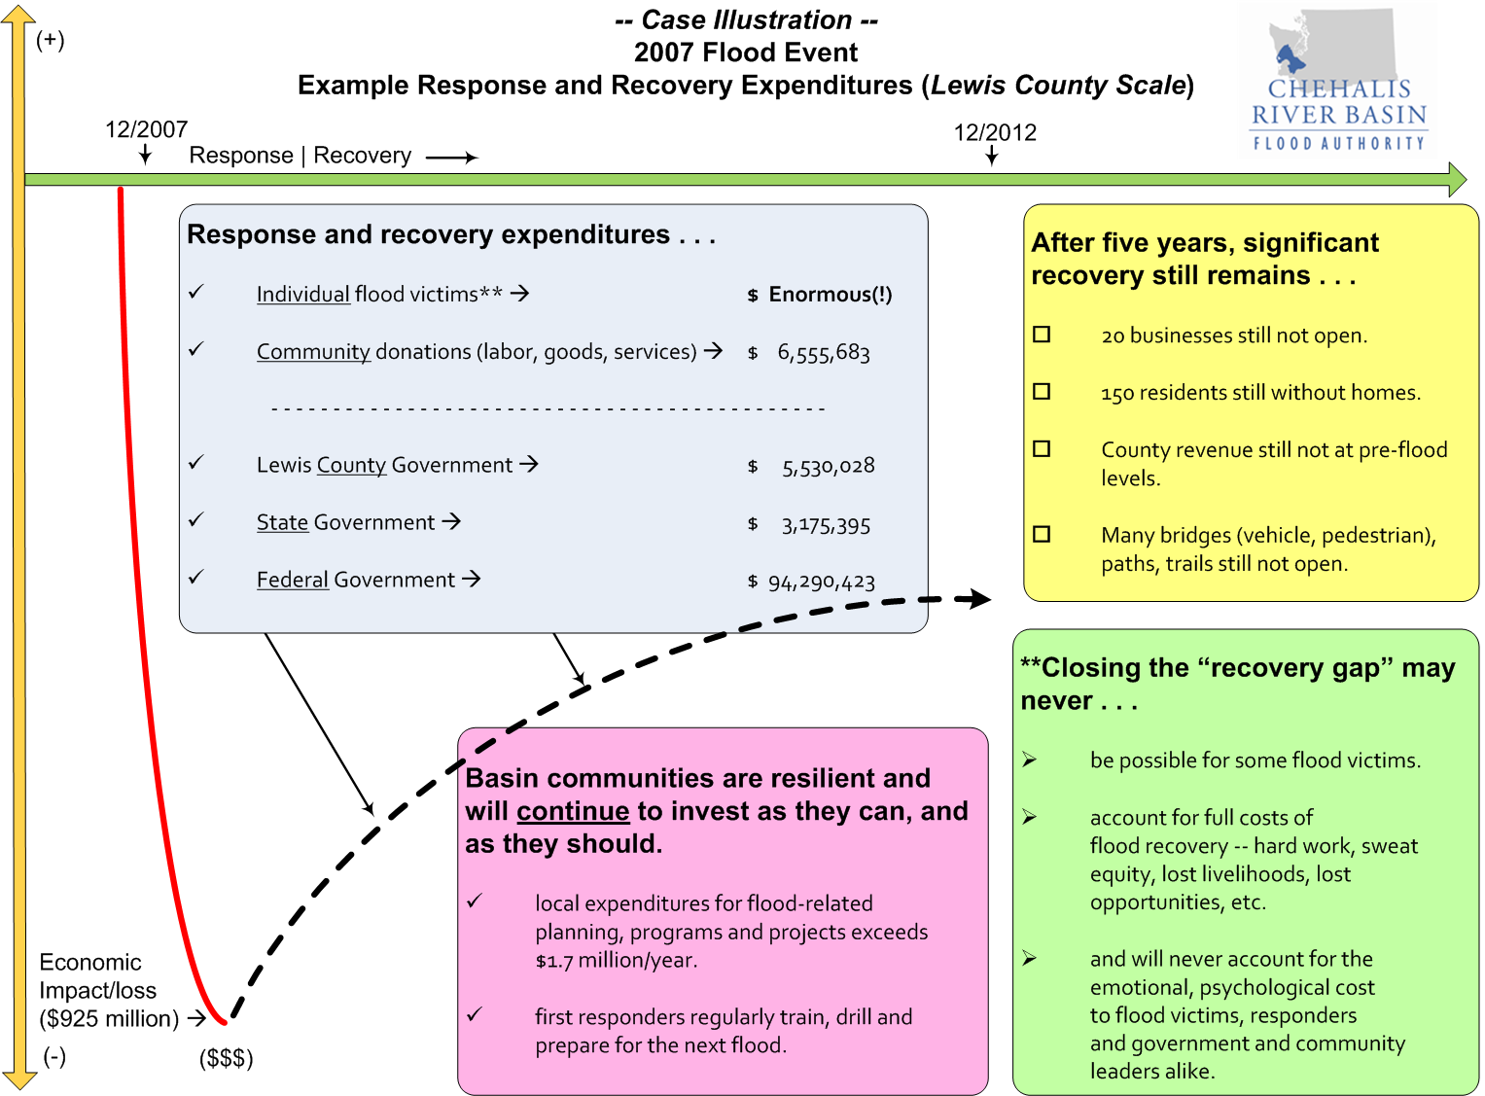
Action -- 2013 Proposed State Capital Budget
Local contribution . . .

Slide 20
Looking Ahead . . .
Continue to focus on local small/mid-scale projects (like was done in 2012 with Jobs Now Act projects).
Major projects:
Upper Basin Dam – Evaluate design alternatives to determine permit feasibility, engineering safety and mitigation requirements by December 2014.
I-5, Airport, Twin Cities – Conduct design and engineering analysis on four protection alternatives.
Continue to improve existing tools (usability improvements to Flood Warning System).
Continue to be a galvanizing force for the Basin.

Slide 21
Resources, Additional Information
Visit Flood Authority’s Web Library for recent documents and products of note (click here).
Flood Warning System Brief Sheet
Flood Authority Funded Additional Flood Warning Gages
Hydraulic Model video presentation
Anchor QEA Fish Studies Summary
Jobs Now Act Projects
Governor’s Work Group Capital Budget Package
Flood Authority Supporting Documentation (All Proposed Projects, Tier I and Tier II)
Ruckelshaus Center’s Chehalis Basin Flood Hazard Mitigation Alternatives Report
Lewis County Flood Authority Website
State of Washington Flood Authority Website
This PPT (Actions and Activities Benefiting the Basin)

Slide 22
Questions? Perspectives? Input?

Slide 23
Thank You!
Vickie Raines, Chair
Chehalis Basin Flood Authority
360/590-4100
vraines@cosmopolis.us.com
Edna Fund, Chair
Education and Outreach Subcommmittee (Flood Authority)
360/269-7515
Edna.Fund@lewiscountywa.gov
Karen Valenzuela, Vice-Chair
Chehalis Basin Flood Authority
(360) 786-5440
ValenzK@co.thurston.wa.us
Scott Boettcher, Staff
Chehalis Basin Flood Authority
360/480-6600
scottb@sbgh-partners.com
Lionel Pinn, Napavine Rep
Chehalis Basin Flood Authority
360/269-5896
lpinn@centralia.wednet.edu

